Slide 1
LUL Youth Development and Education Project
JKL Systems

Slide 2
Overview
Team Introduction
Current System
Issues
Business Requirements
Business Values
The Next Step
Notes:
Josh

Slide 3
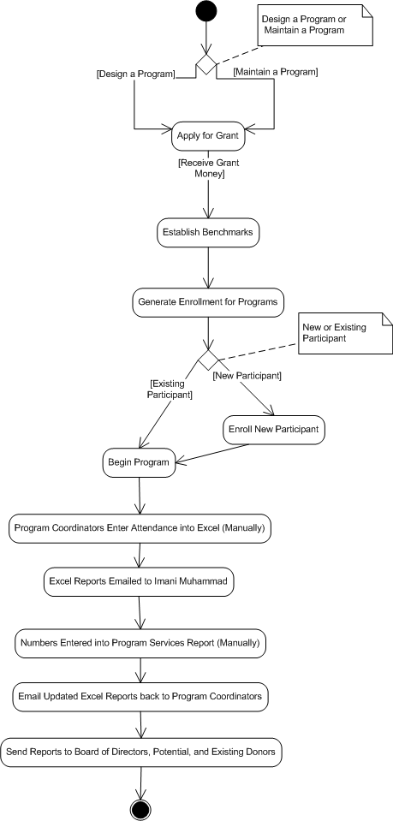
Current System State (“As-is”)
Kelsi’s fill in
Notes:
Kelsi

Slide 4
Issues
Efficiency in reporting
Data input
Decentralized data storage
Retrieval of data
Inefficient use of time
Potential loss of grant funding (revenue)
Ineffective use of current IT resources
Notes:
Leslie

Slide 5
Business Requirements
Produce user friendly reports
Store program information in centralized location
Smooth transition from data input to output
Produce reports from consolidated data upon user’s requests

Slide 6
Business Values
Increase Grant Funding
Develop new programs
Better use of IT infrastructure
More efficient use of time
Better process for tracking program data
Reduced manual data processing

Slide 7
Recap
Current System
Issues
Business Requirements
Business Values
Notes:
Josh

Slide 8
The Next Step…
Analyze various risk factors
Consider how to implement new system
Complete Feasibility Analysis
Refine “To-Be” system process flows
Notes:
Josh

